Slide 1
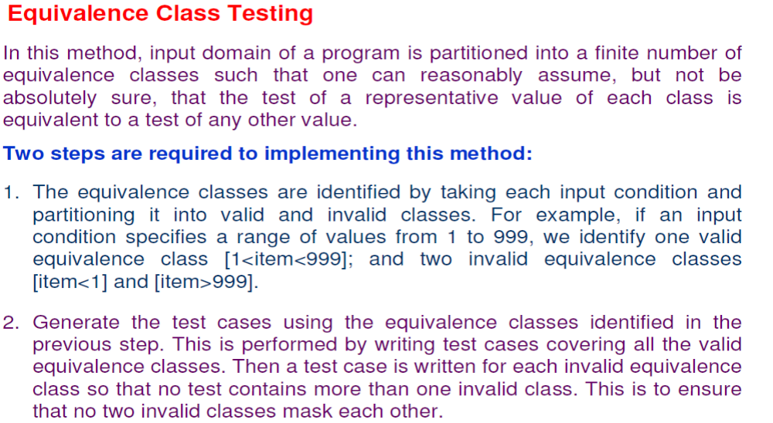
Software Testing
Functional Testing / black box /behavioral

Slide 2
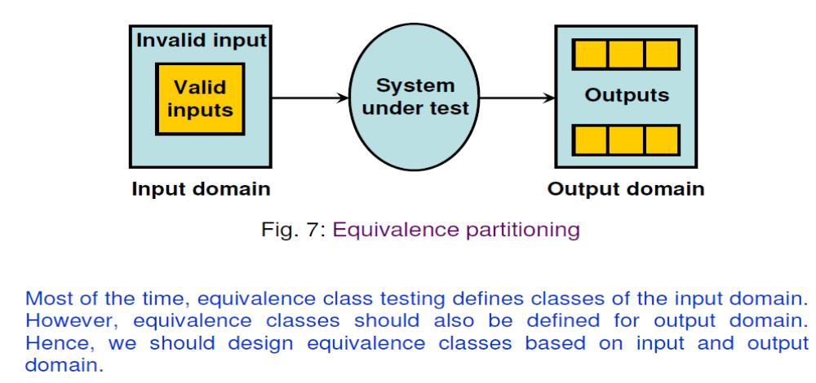
Software Testing
Functional Testing / black box /behavioral
Equivalence class testing

Slide 3
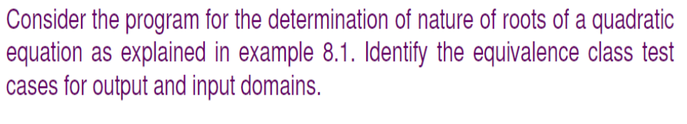
Software Testing
Functional Testing / black box /behavioral
Equivalence class testing

Slide 4
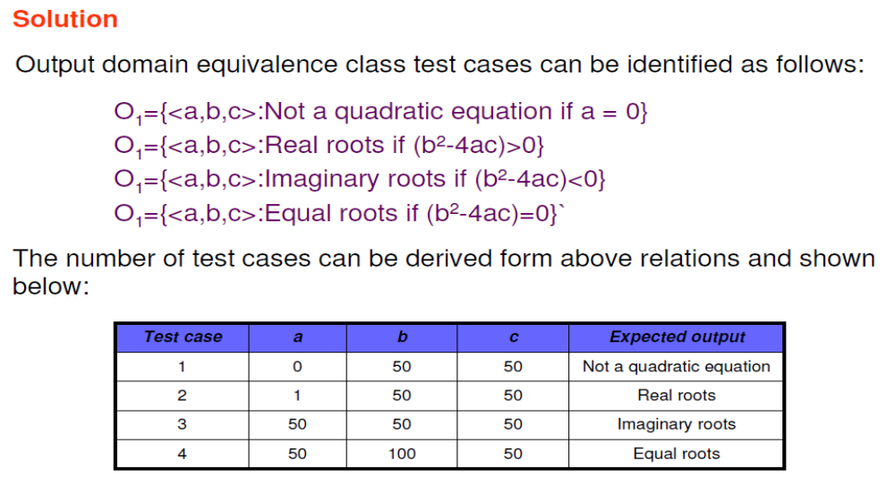
Software Testing
Functional Testing / black box /behavioral
Equivalence class testing

Slide 5
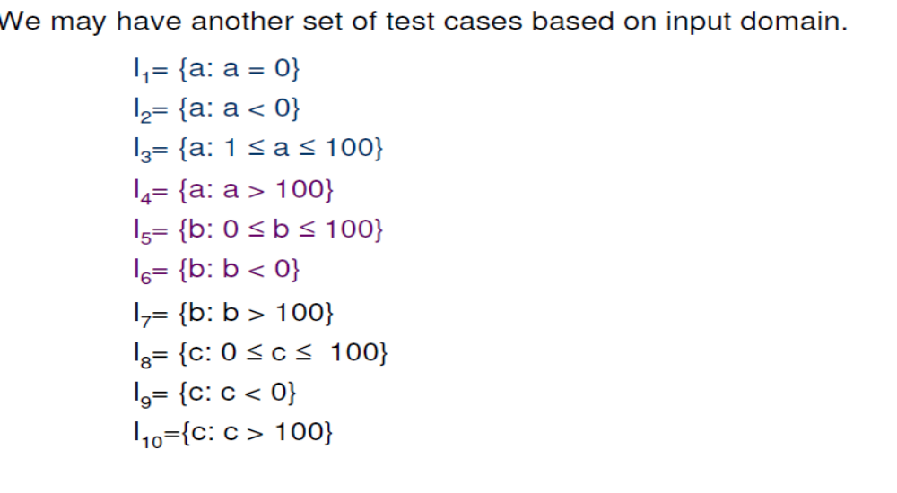
Software Testing
Functional Testing / black box /behavioral
Equivalence class testing

Slide 6
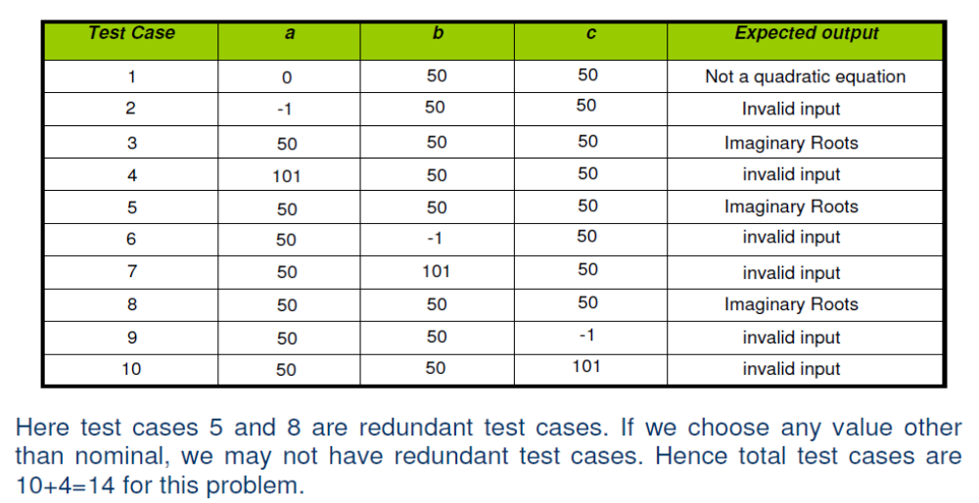
Software Testing
Functional Testing / black box /behavioral
Equivalence class testing

Slide 7
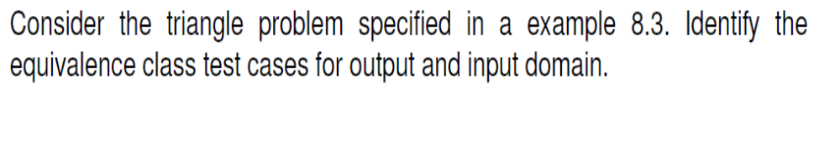
Software Testing
Functional Testing / black box /behavioral
Equivalence class testing

Slide 8
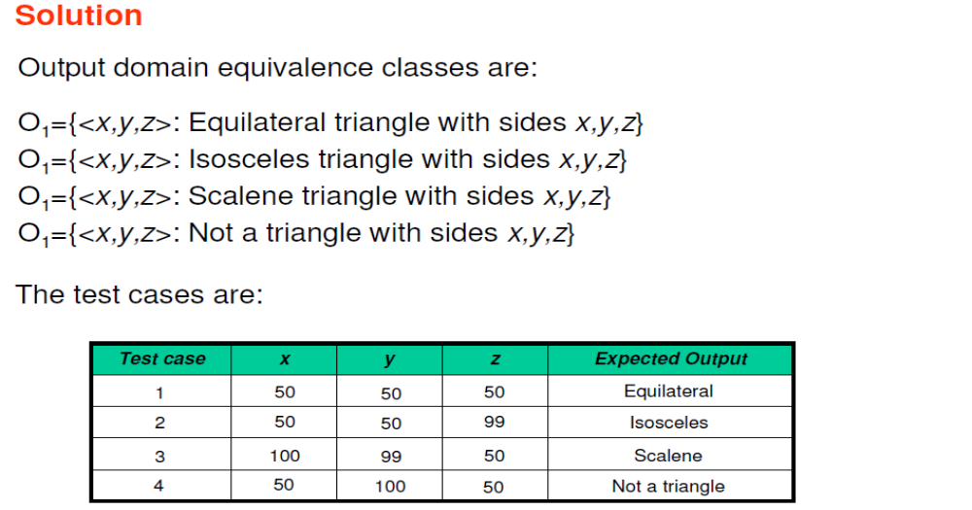
Software Testing
Functional Testing / black box /behavioral
Equivalence class testing

Slide 9
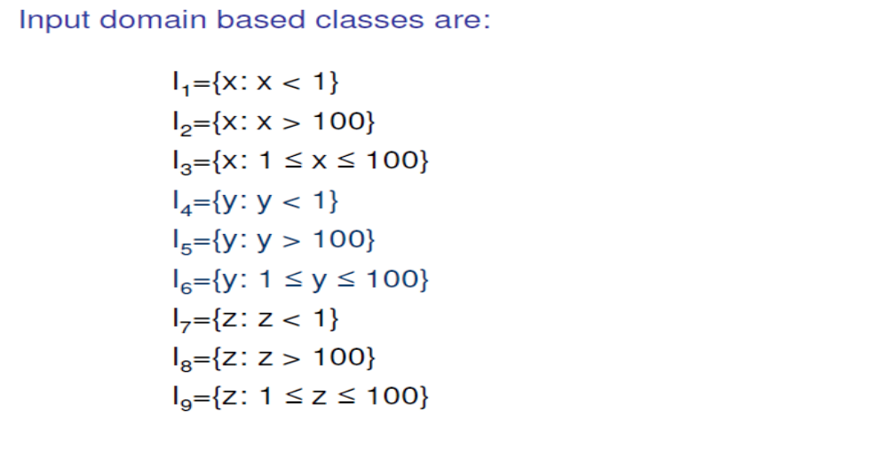
Software Testing
Functional Testing / black box /behavioral
Equivalence class testing

Slide 10
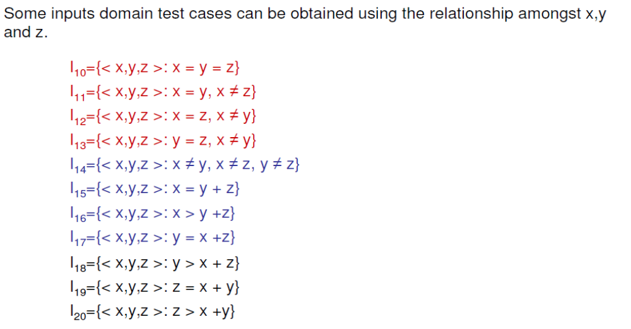
Software Testing
Functional Testing / black box /behavioral
Equivalence class testing

Slide 11
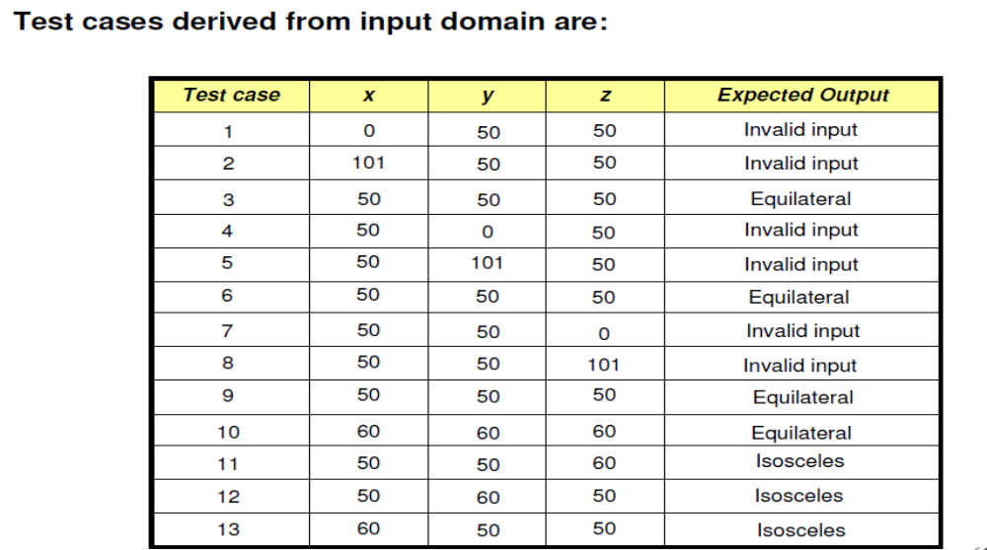
Software Testing
Functional Testing / black box /behavioral
Equivalence class testing

Slide 12
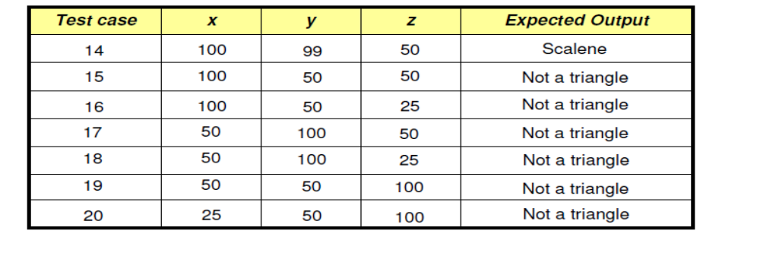
Software Testing
Functional Testing / black box /behavioral
Equivalence class testing

Slide 13


Slide 14
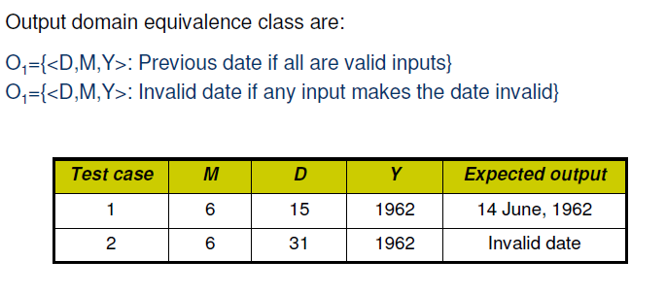

Slide 15
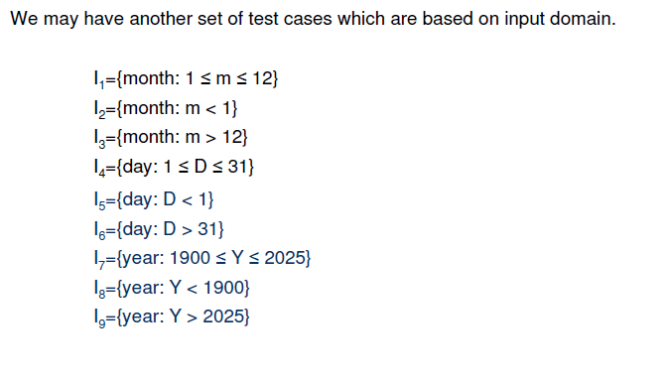

Slide 16
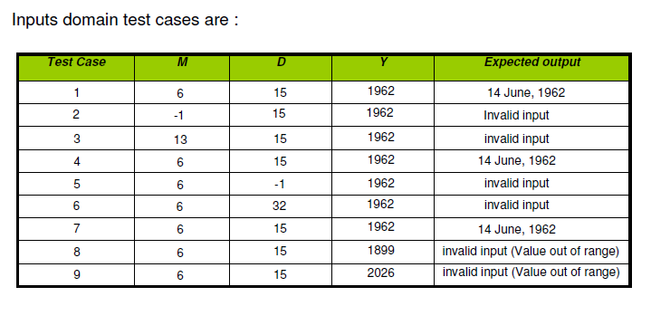

Slide 17
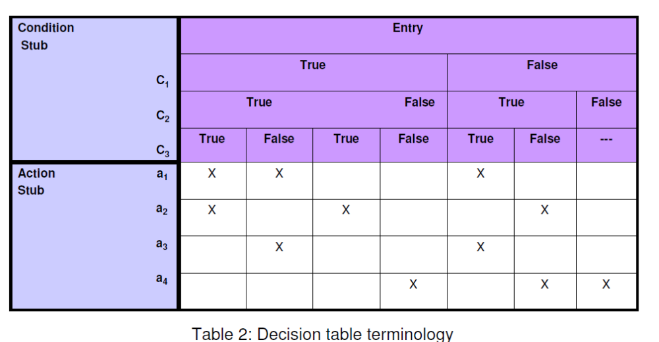
Software Testing
Functional Testing / black box /behavioral
Decision table based testing

Slide 18
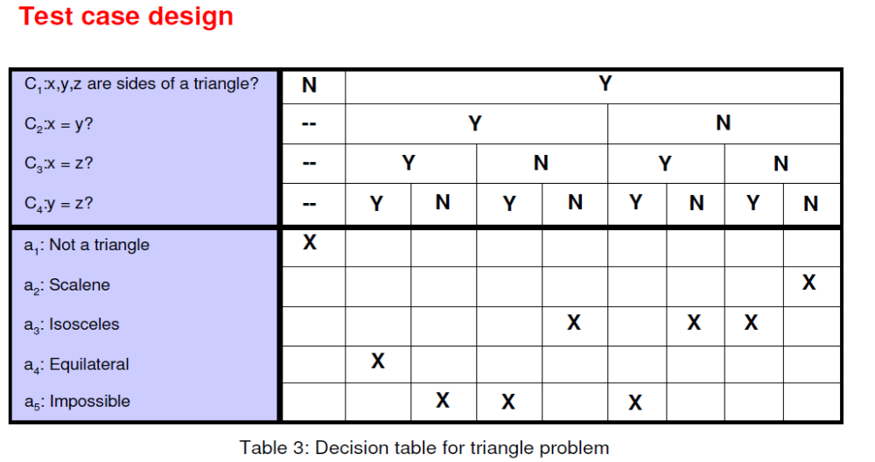
Software Testing
Functional Testing / black box /behavioral
Decision table based testing

Slide 19
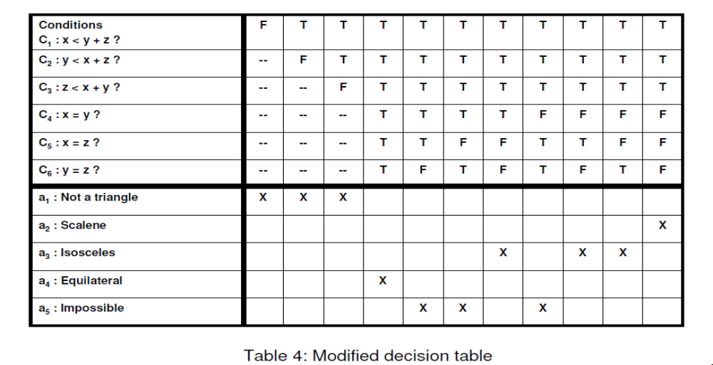
Software Testing
Functional Testing / black box /behavioral
Decision table based testing

Slide 20
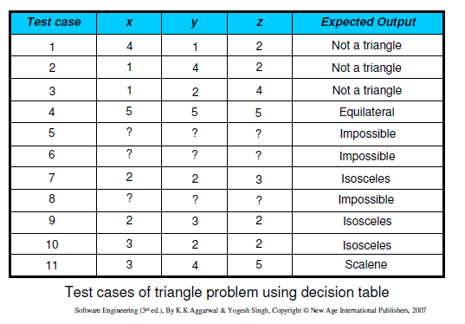

Slide 21
References
K.K. Aggarwal and Yogesh Singh, “Software Engineering”, Third Ed., New Age International (P) Limited Publishers. (2009).
Roger S. Pressman, “Software Engineering: A Practitioner’s Approach”, Fifth Ed., McGraw–Hill Higher Education, (2001).
Rajib Mall, “Fundamentals of Software Engineering”,Fourth Ed., PHI Learning Private Limited, (2016).
Pankaj Jalote, “An Integrated Approach to Software Engineering”, Third Ed., Narose Publishing House, (2008).

Slide 22
Thanks…

